Slide 1


Task 3: Data Visualization & Storytelling

Slide 2


Today's agenda
Project recap
Problem
The Analytics team
Process
Insights
Summary

Slide 3

Social Buzz is a content-centric social media platform founded in 2008 by former engineers. With over 500 million active users monthly, they track user reactions to trending content and are seeking external expertise for scaling, an upcoming IPO, and managing big data challenges.
Tasks at Hand
An audit of their big data practice
Recommendations for a successful IPO
An analysis of their content categories that highlights the top 5 categories with the largest aggregate popularity
Project Recap

Slide 4

Problem
Managing and analyzing a massive amount of unstructured data, with over 100,000 pieces of content posted daily. Scaling has become a pressing issue, as the platform has reached over 500 million active users each month. To prepare for an upcoming IPO and learn best practices, they require external expertise in handling the complexities of big data.

Slide 5



Andrew Fleming
Chief Technology Architect
The Analytics team
Marcus Rompton
Senior Principal
Ayush Jain
Data Analyst

Slide 6
Process
1
Data Understanding
2
Data Cleaning
3
Data Modelling
4
Data Analysis
5
Data Visualisation

Slide 7
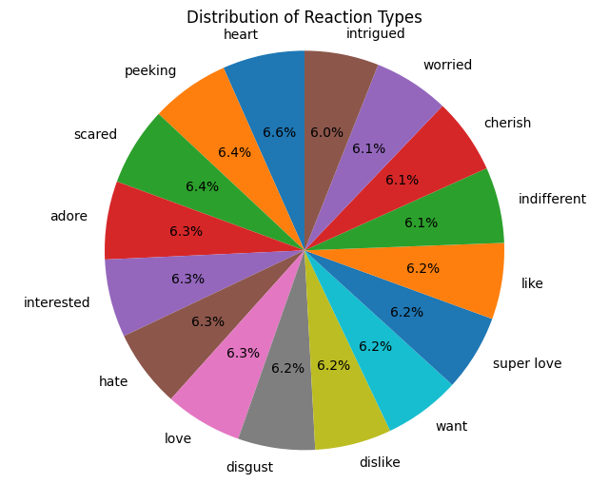
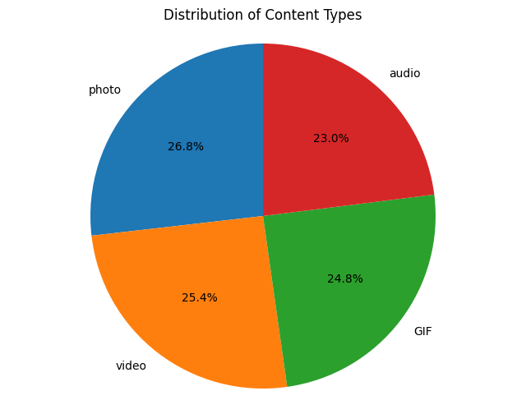

Insights

Slide 8
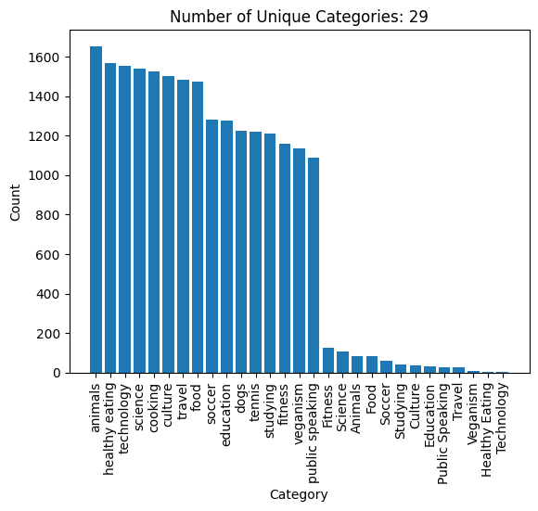
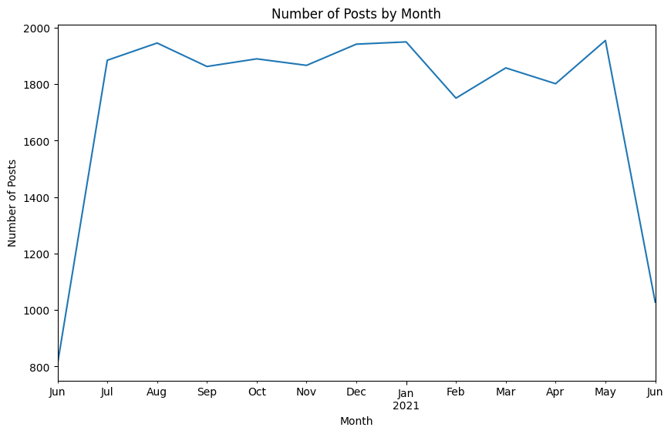

Slide 9
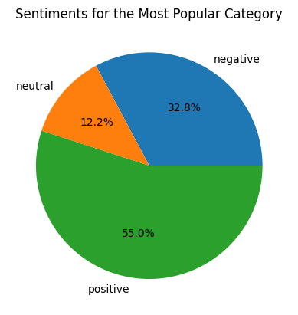
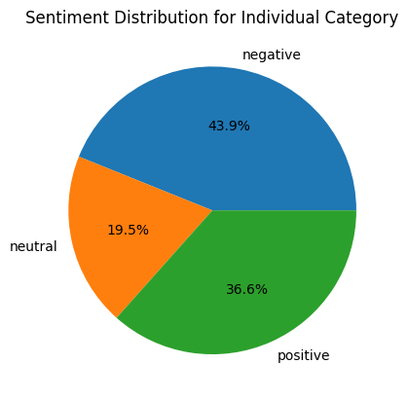

Slide 10

Type of content is almost equally distributed
Aug, Jan and May saw the most number of posts
Number of unique categories = 29
Top 5 Categories = animals, healthy eating, technology, science, and culture
Users post content that higher negative sentiment but prefer content with higher positive sentiment.
Summary

Slide 11
Thank you!
ANY QUESTIONS?

